Slide 1

Team 3 – Autonomous Driving
Tibor von Gencsy
Technische Universität München
TUM School of Computation, Information, Technology
München, 30. Juli 2024

Slide 2
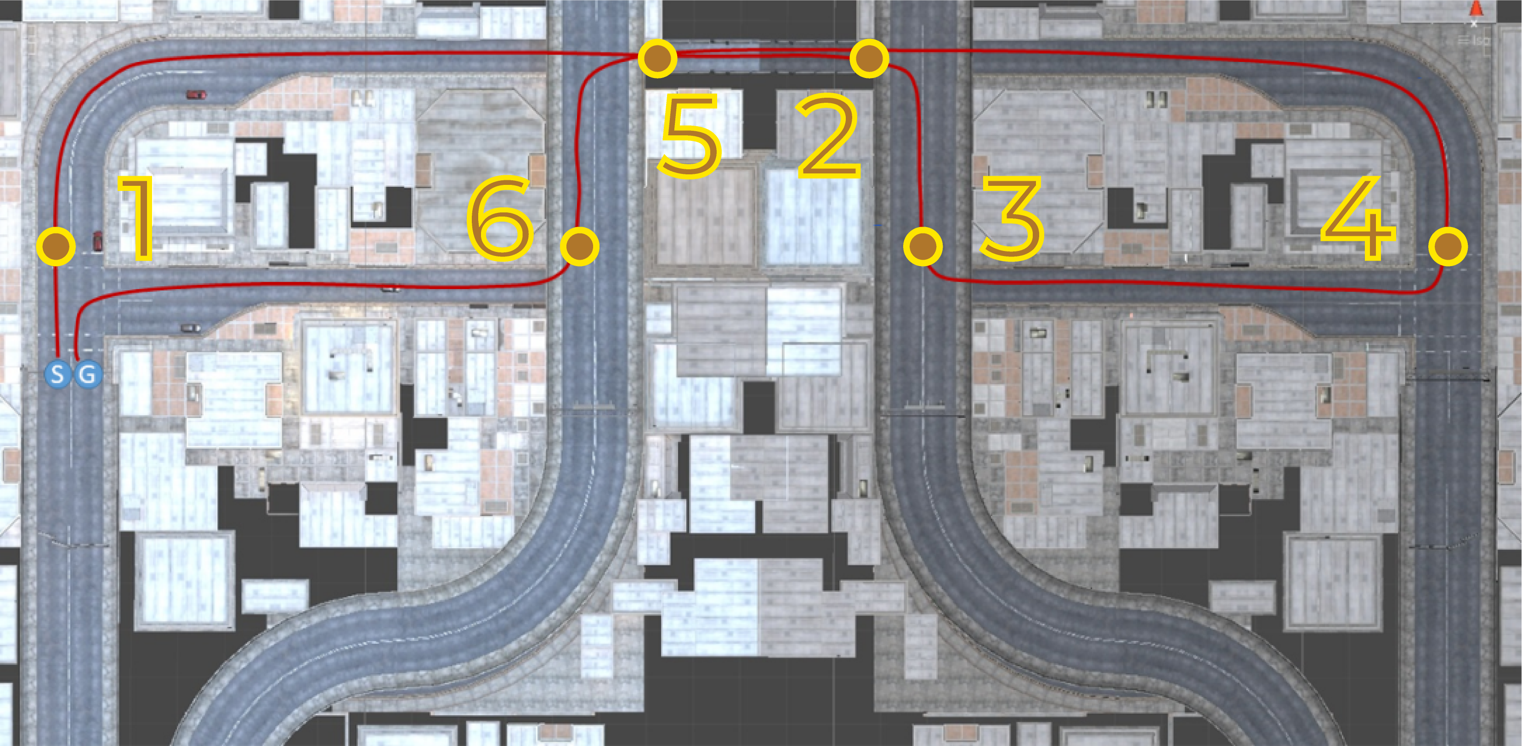
Initial Idea

Slide 3
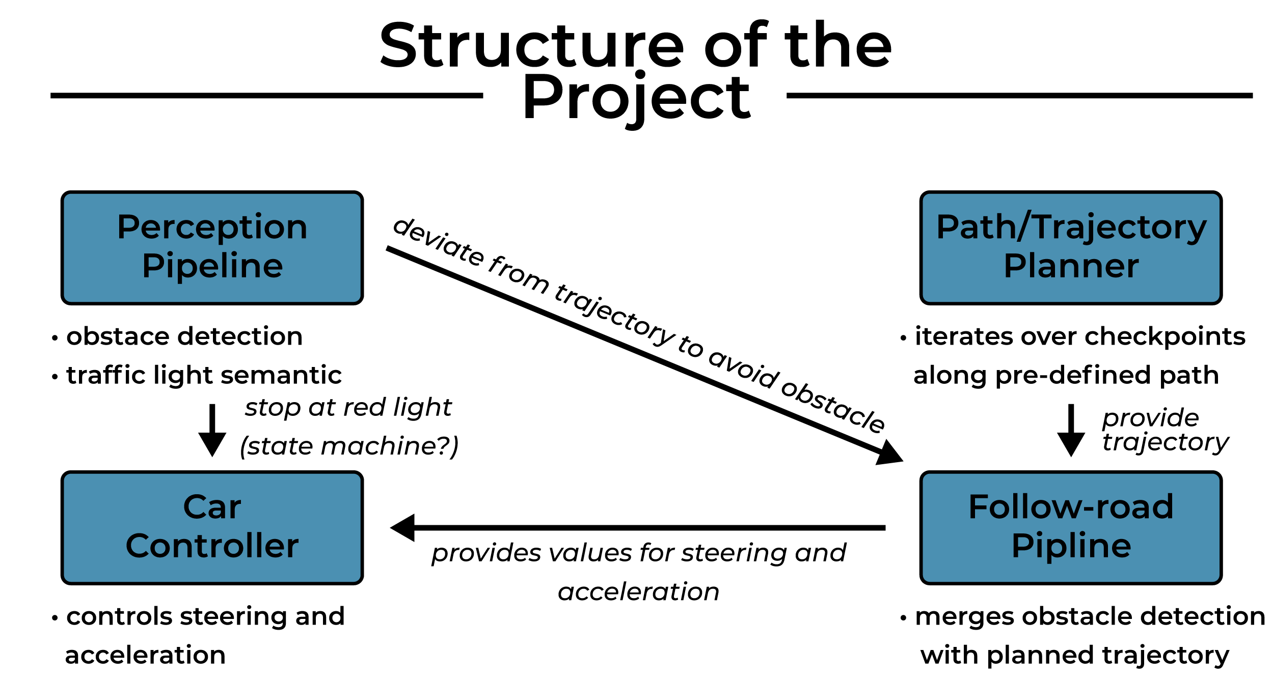

Slide 4
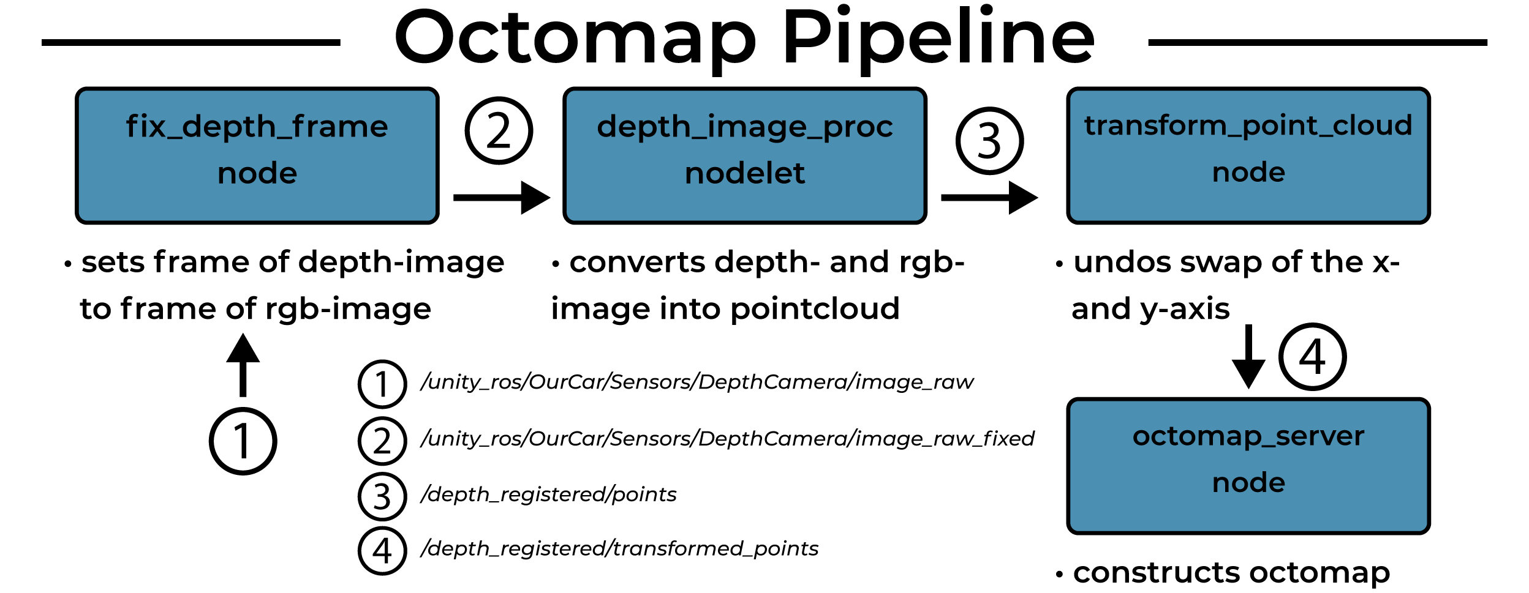

Slide 5
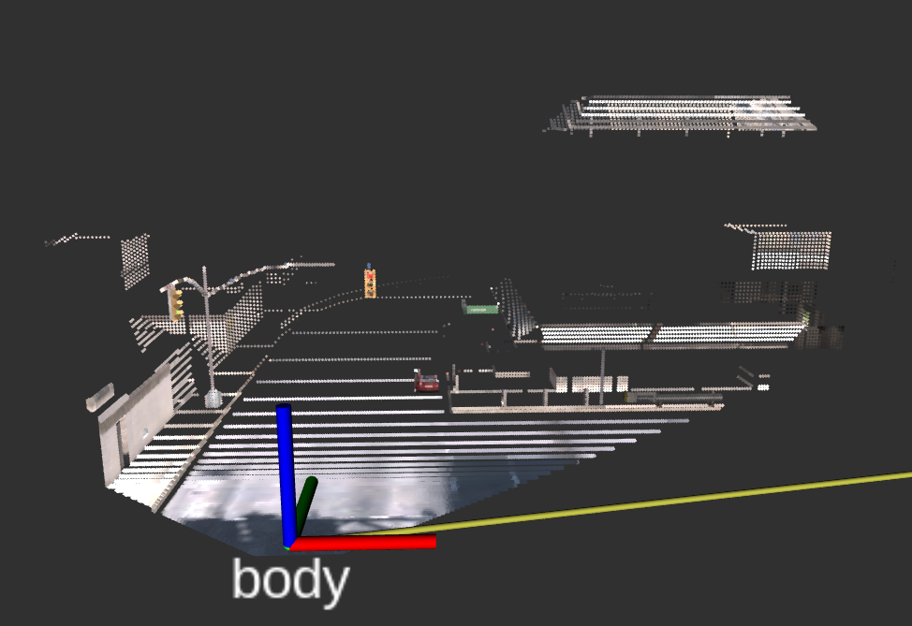
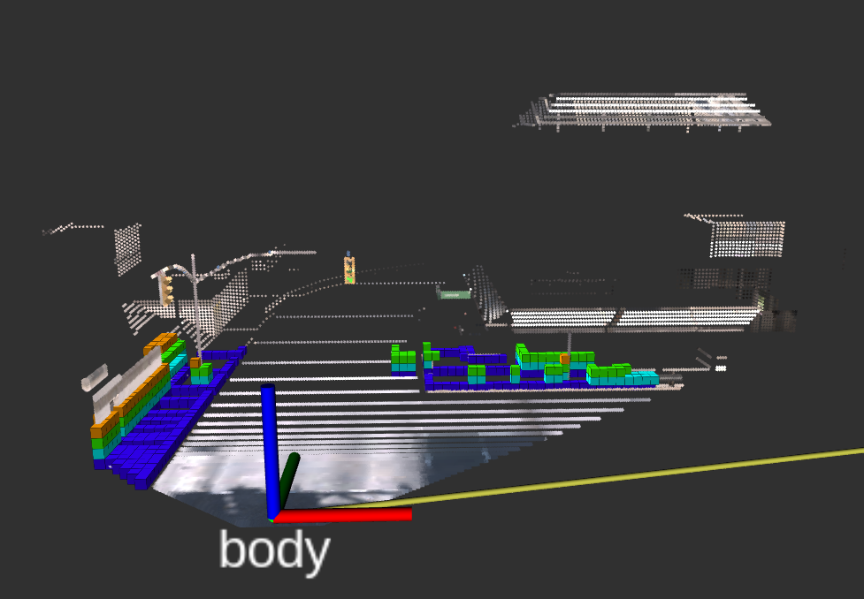
Octomap Pipeline
(a) Projected pointcloud.
(b) Octogrid constructed from projected pointcloud.

Slide 6
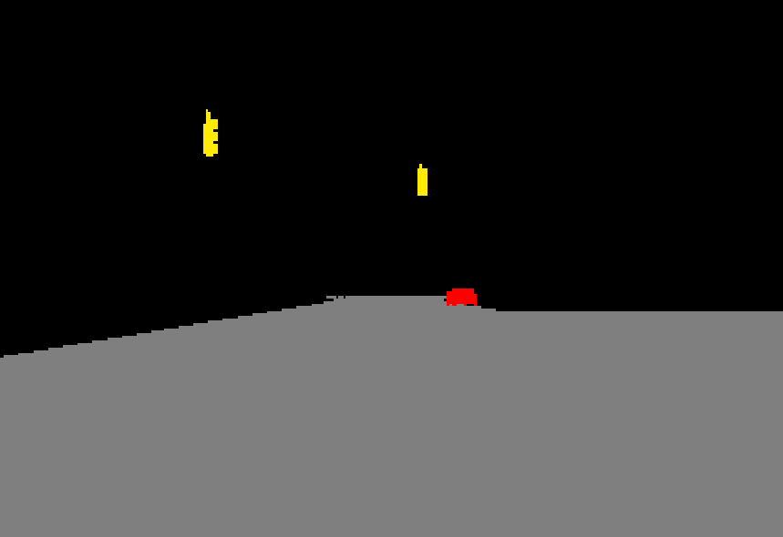
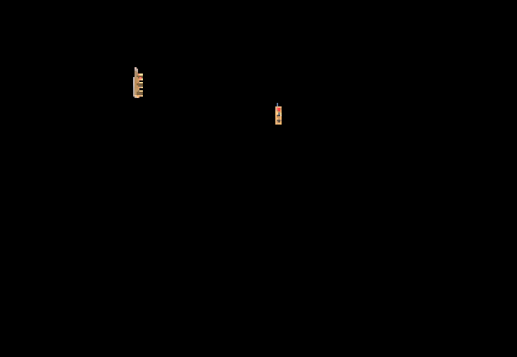
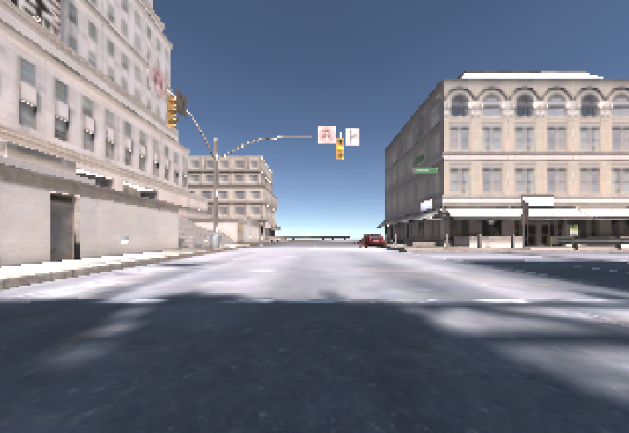
Traffic Light Detection

Slide 7
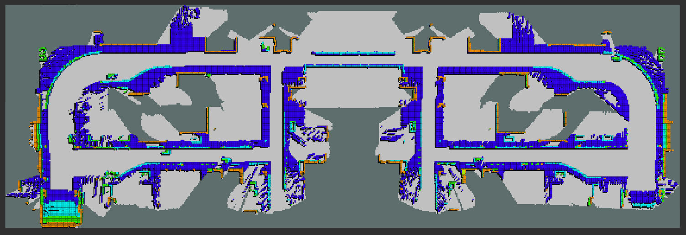
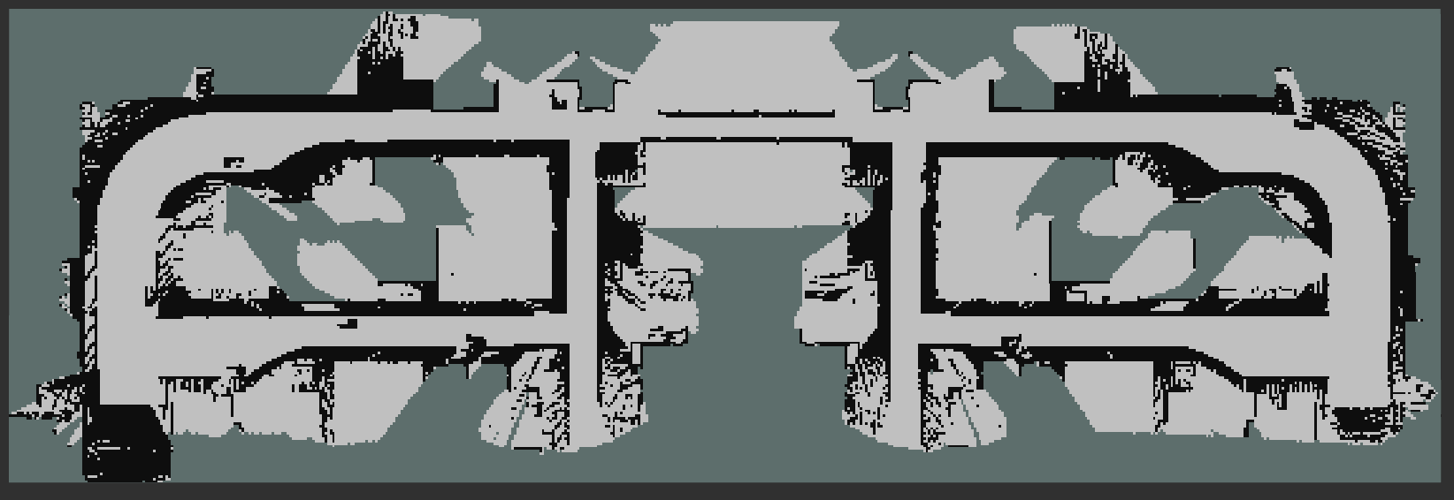
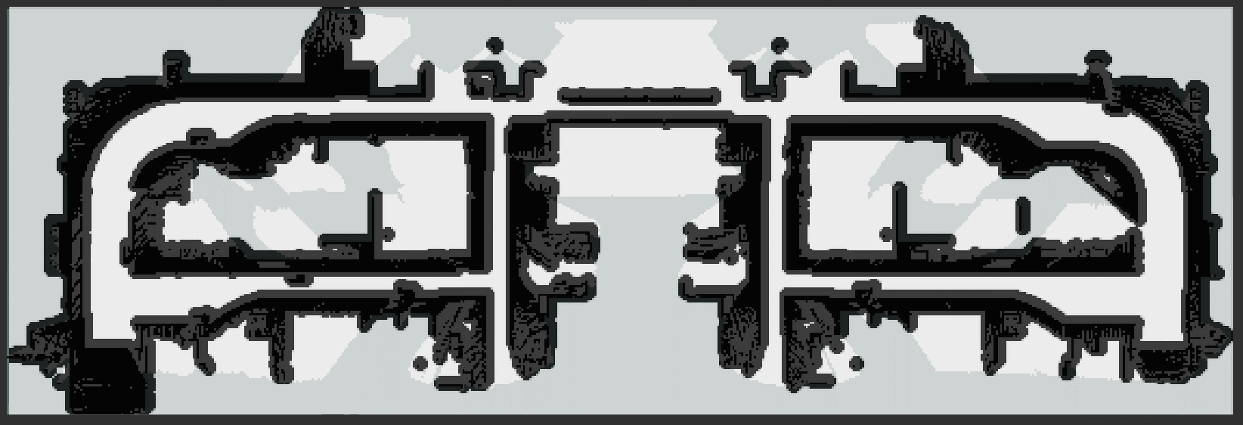
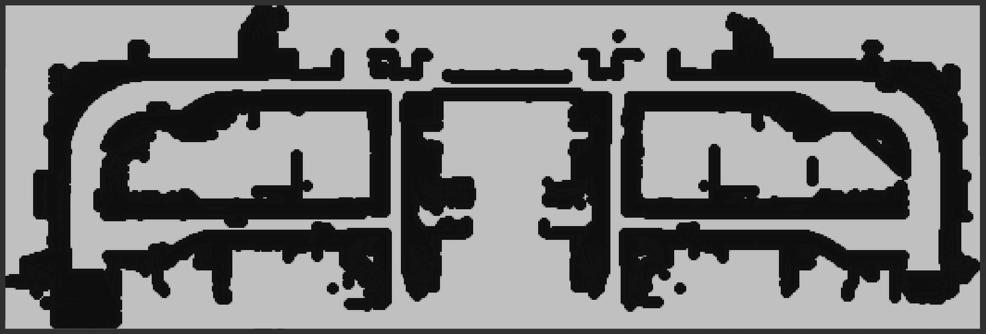
Costmap

Slide 8
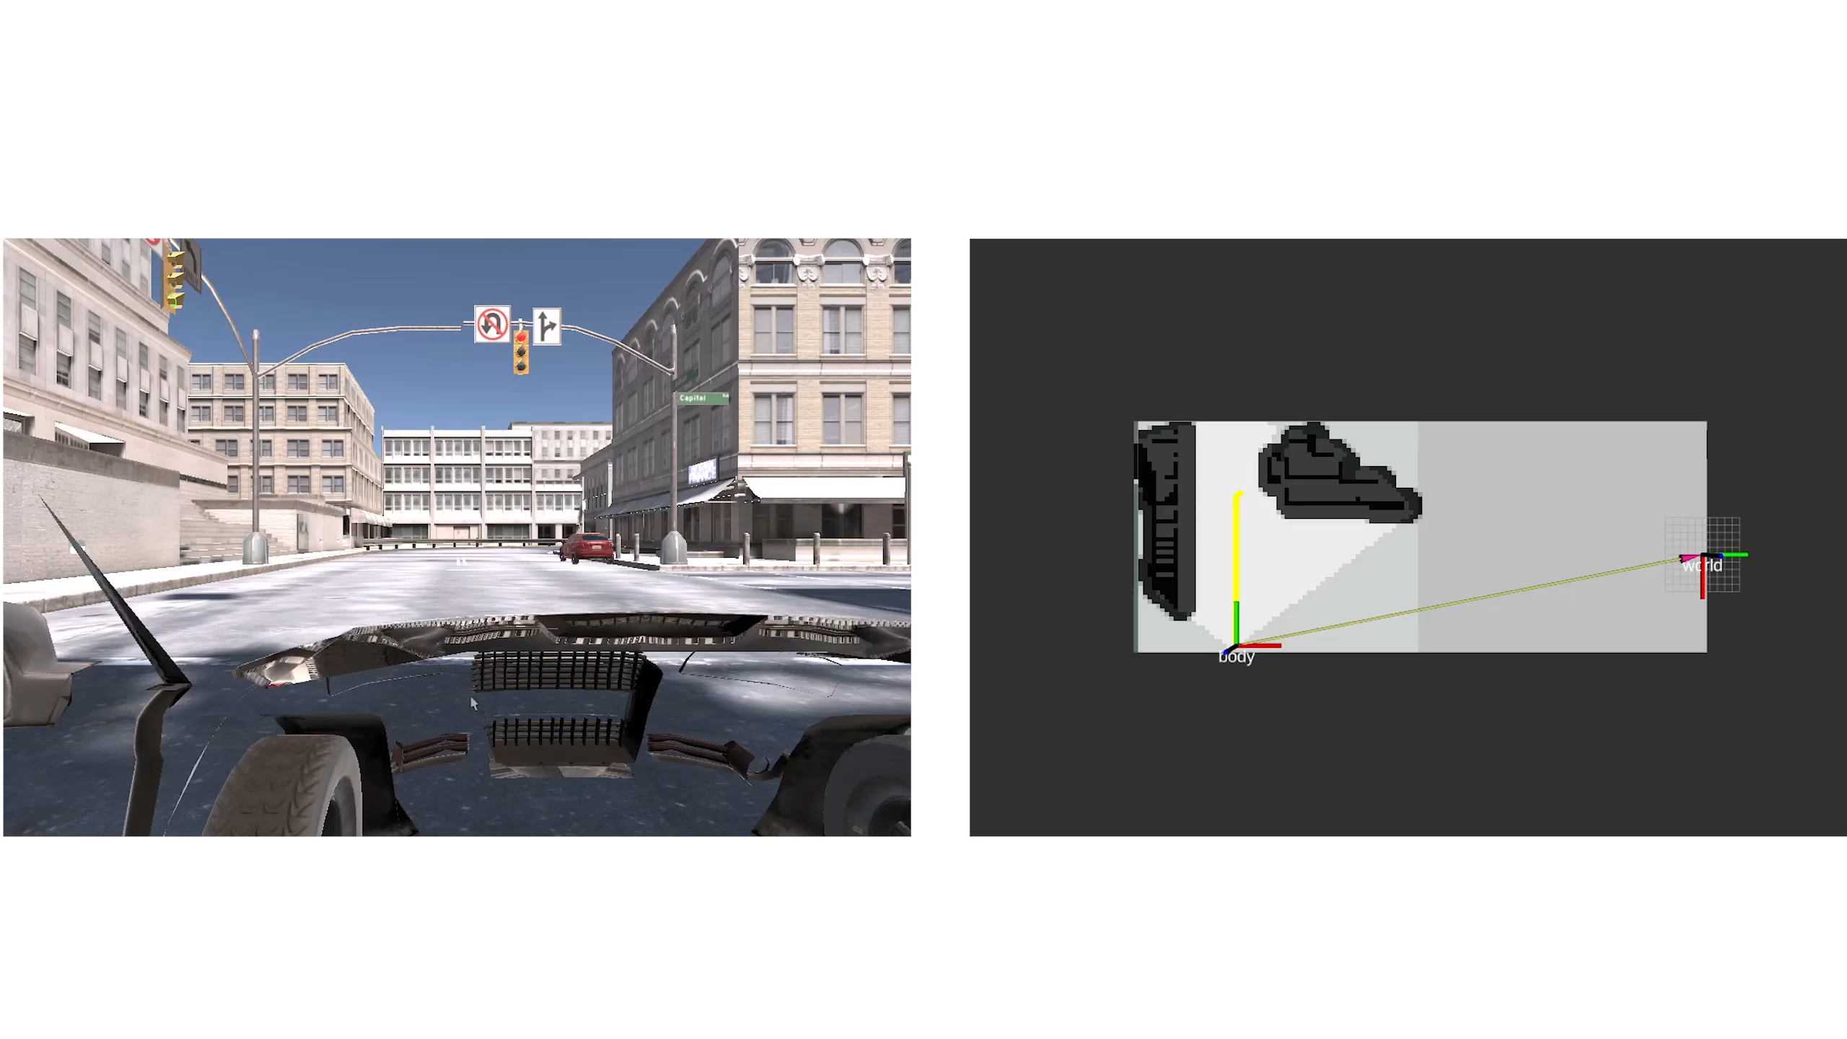
Path Planning

Slide 9
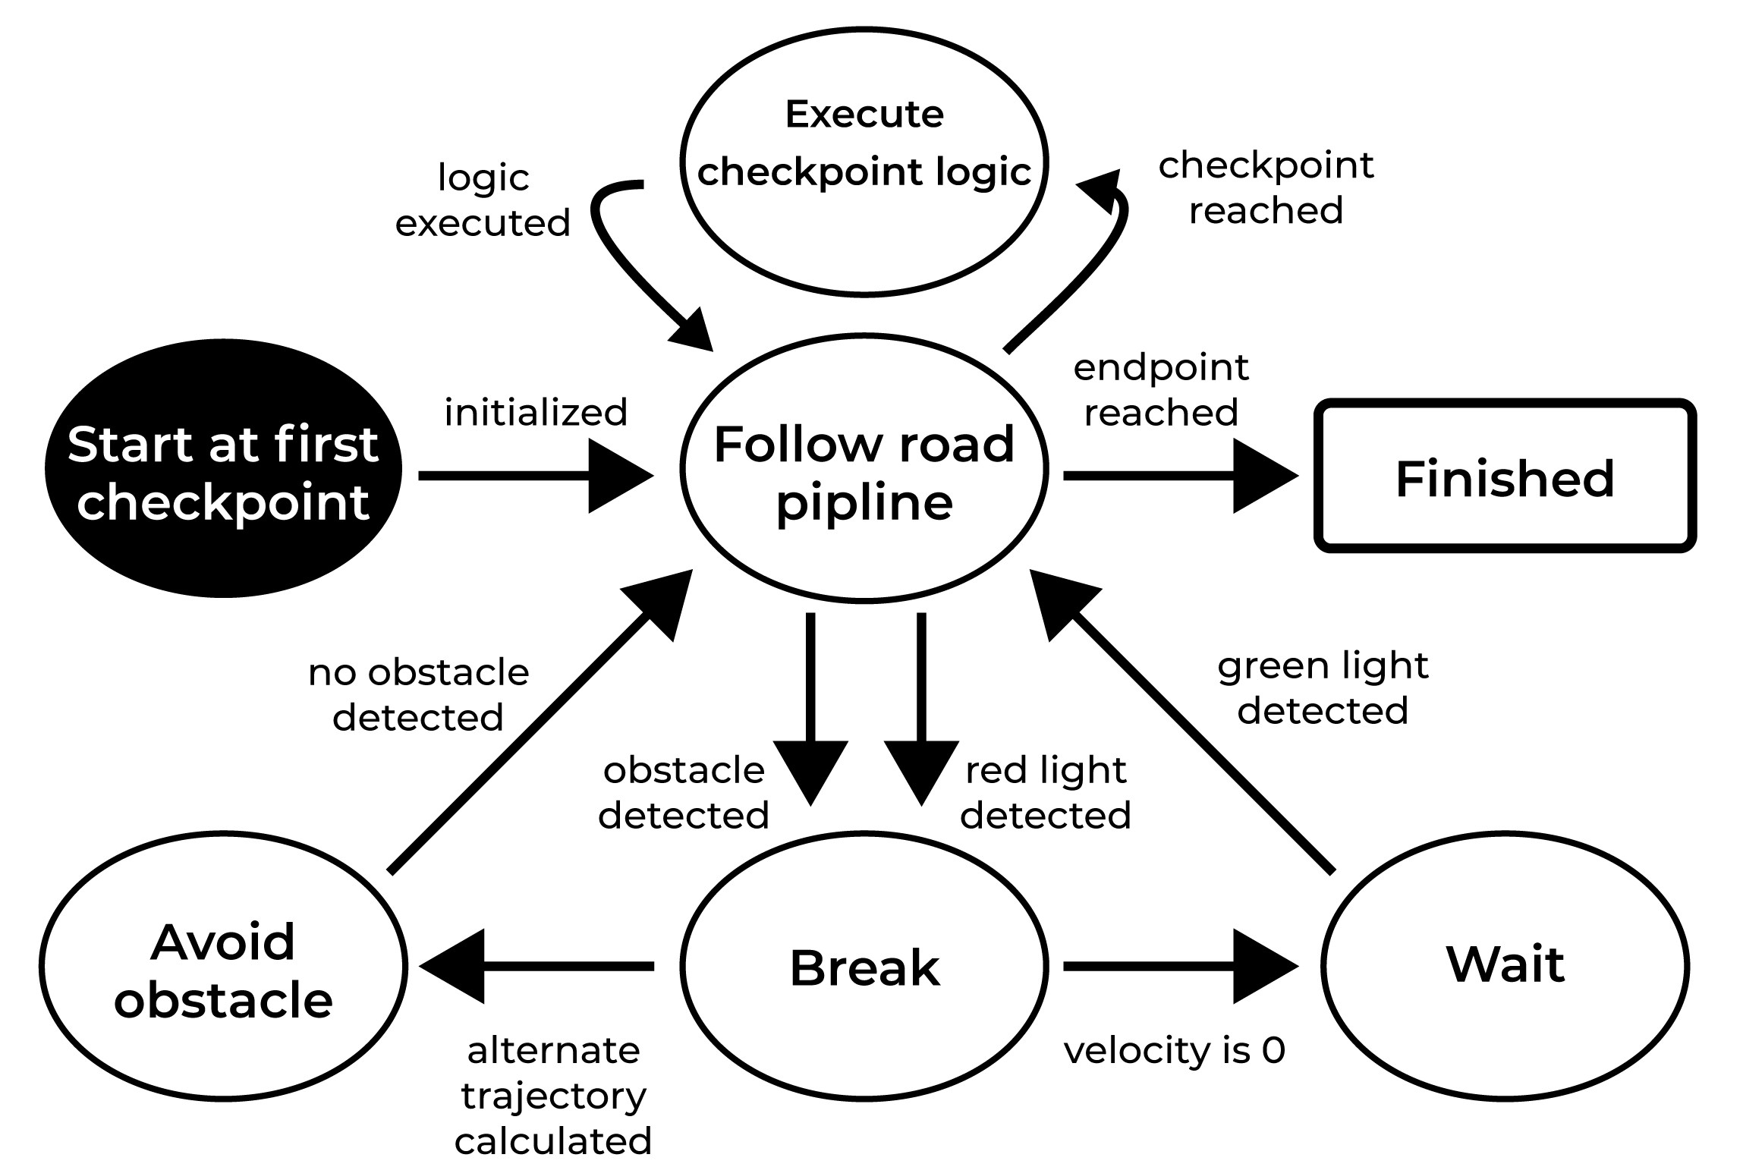
State Machine

Slide 10
Open Problems
Drift-compensation
Local path planner
Car controller
Checkpoint publishing
Simulation and Rviz crashes

Slide 11

Questions

Slide 12
